Slide 1
Stallion RFID My-Asset Tracking System
PMO
BRAND AID PVT.LTD.

Slide 2
STA My-Asset System
A company is known and valued by its assets. STA My-Asset Tracking System enables efficient management of fixed or movable assets and also helps in maintaining the complete history of assets with automated processes.
STA My-Asset Systems is a user-friendly, commanding tool which intensifies businesses with large range of features. It is extremely compatible with different types of readers and tags and can generate a wide combination of reports.
While it enables seamless asset management at the operational level, the advanced reporting capabilities of STA My-Asset Systems enables the strategic management to take informed decisions to optimize performance of every asset.

Slide 3
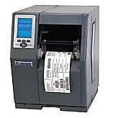
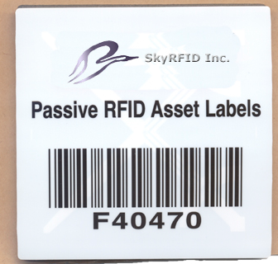
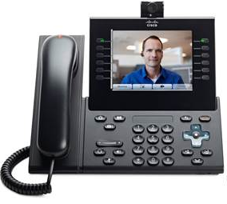

Asset Registration Process
Tag Registration & Printing
Tag & Fixing Mechanism
Registered Tag Affixed On Asset

Slide 4

Reader
LAN Cable
RF Cable
2ft
ANT-1
ANT-2
1 ft
4.5ft
Conduit Pipe 2.5” (for laying RF Cable)
6ft
ANT-3
ANT-4

Slide 5
Hall Entrance Door
LAN Cable
Reader
RF Cable
2ft
ANT-3
ANT-2
ANT-1
1 ft
4.5ft
INSIDE
OUTSIDE
6ft
ANT-2
ANT-4
Ground View
ANT-3
front view

Slide 6
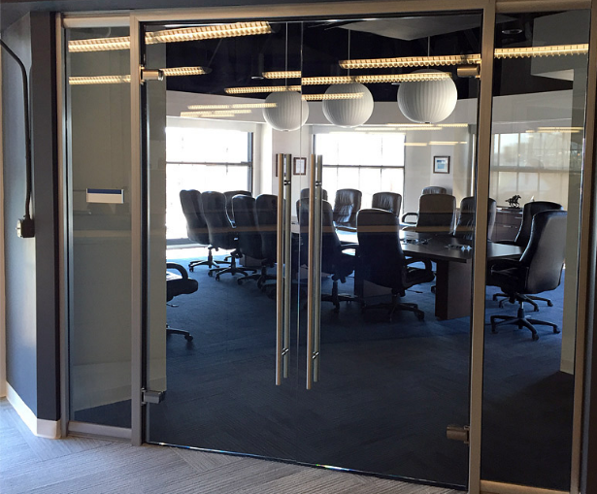


Main Entrance OF Conference Room
Reader
LAN Cable
RF Cable
ANT-1
ANT-2
If user try to take out asset without permission
My-Asset System will record the log of appropriate
asset & Alert will going to be authorized person
Conference Rom Entrance
RFID Tagged Asset on Table
ANT-3

Slide 7
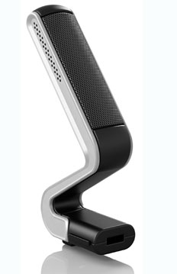
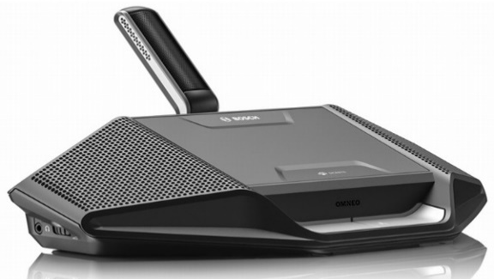
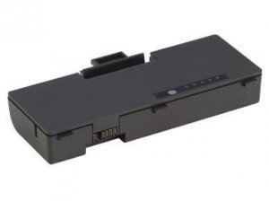
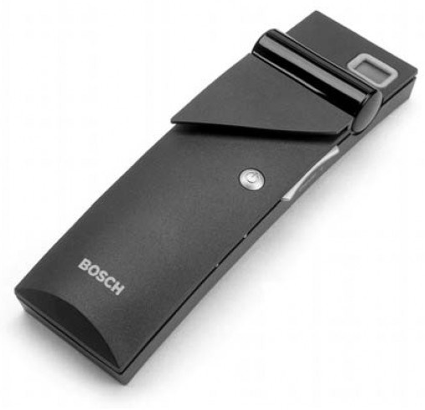
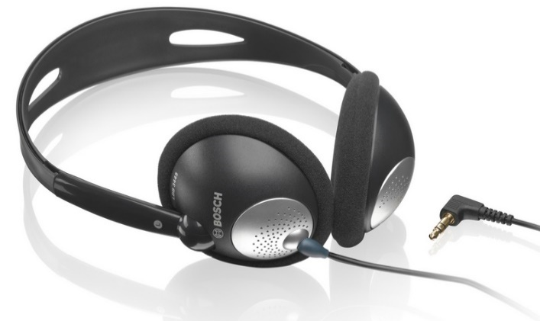
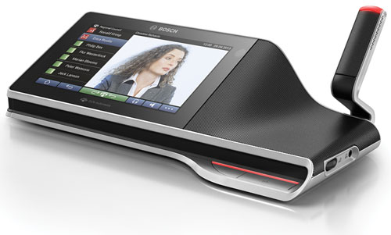
Asset Tagged with UHF RFID Tag

Slide 8
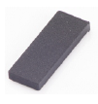

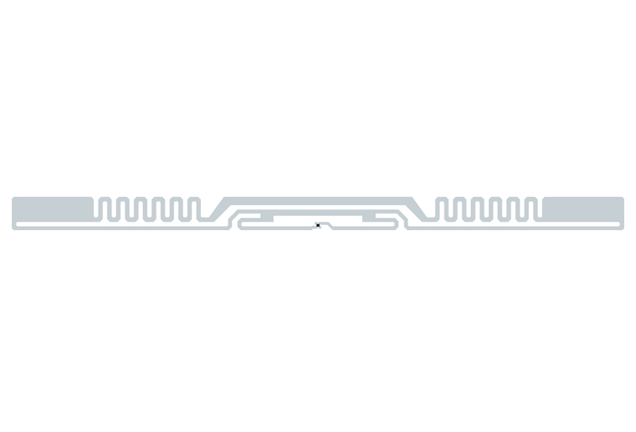
Used RFID Hardware
UHF Desktop Reader
UHF Fixed Reader
UHF Antenna
UHF Ceramic Tag
UHF Viper Inlay
UHF MiniWeb Inlay

Slide 9
STA My-Asset System enables the following:
Monitoring and tracking Asset movement
Better Asset visibility and Asset utilization
Quick allocation of Assets and immediate update on their status
Identification of the deviations from expected Asset location or condition
Generation of trigger/exception based alerts or specific warning notifications
Access to historical data for identification and elimination of operational bottlenecks
Maintenance of Asset inventories and validation of the Asset utilization

Slide 10
Benefits of STA My-Asset Tracking System
Fully automated: My-Asset is a paperless, fully digitized and flexible tracking and management solution which can work with multiple readers and databases. Total asset aging and history can be maintained and viewed at all times. Every asset can be linked to multiple users and vice-versa. Details of assets and assigned tags can be printed as labels using a label printer
Alerts and Alarms: Warranty, tracks and schedules maintenance and expiry dates are maintained and alerts and alarms are given to user accordingly. Alerts and alarms are also given when a user or asset enters to unpermitted area. Alerts are received on SMS and Email to ensure that the user reads and responds instantly.
Quick and advanced search and efficient report generation: User –friendly report generation rendered as graphs and charts, coupled with features to slice, dice and sort data and save in all formats (Microsoft excel as well) empowers the users of My-Asset to make swift and informed decisions.
Support Group of companies: My-Asset can be implemented to track assets across multiple (group of) companies thereby creating a unique asset management and tracking system at a group level.

Slide 11

Thank You

